Slide 1
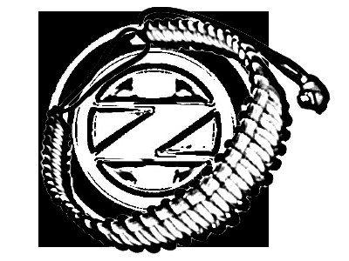
Outer Zone Overnight
06/08/2013
Paracord : Cobra stitch
How to make a Survival Bracelet

Slide 2
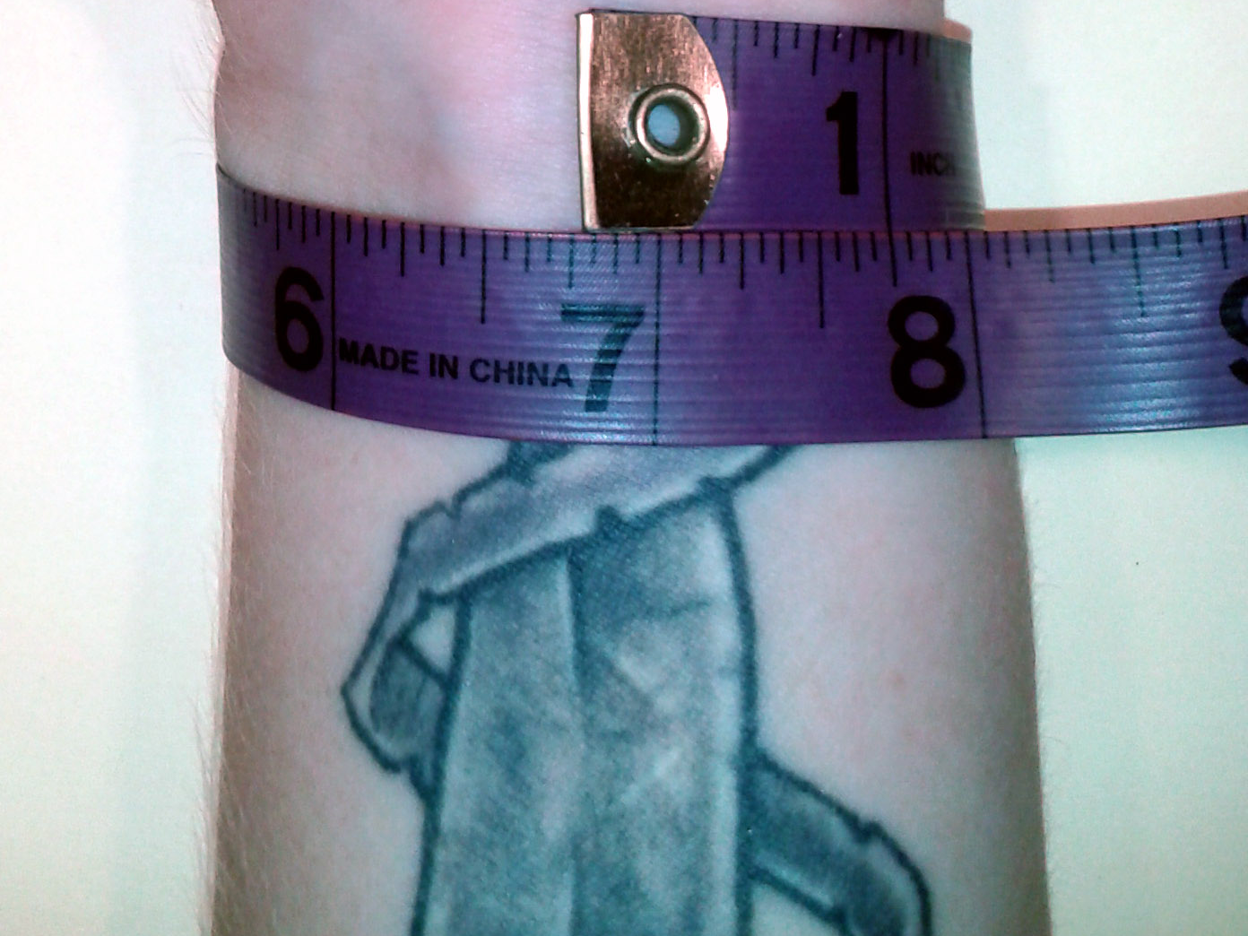
Step 1: Measure wrist
Snug, but not too snug…For every inch of measurement, use one foot of paracord. Hint : Round up.

Slide 3
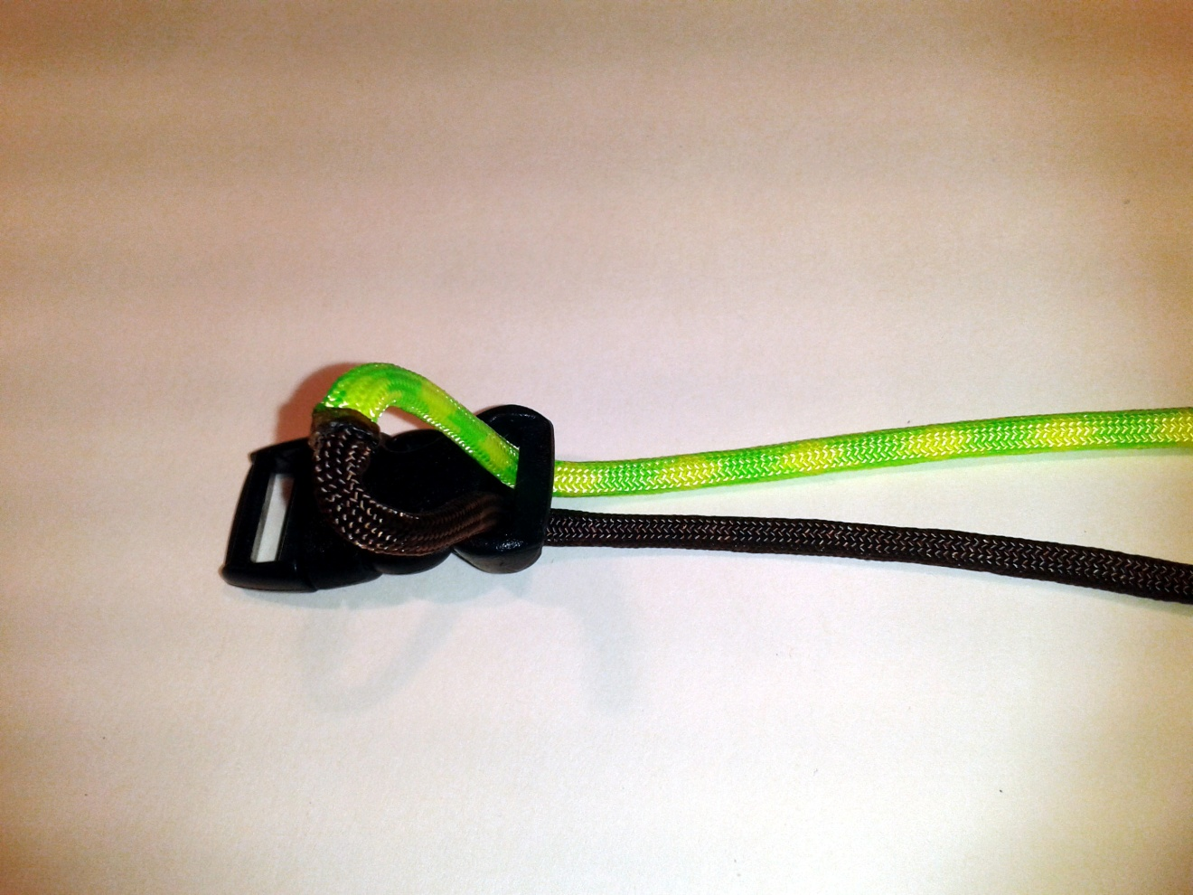
Step 2: Feed paracord loop through buckle
Find the center of the paracord length, and feed a loop through the buckle.

Slide 4
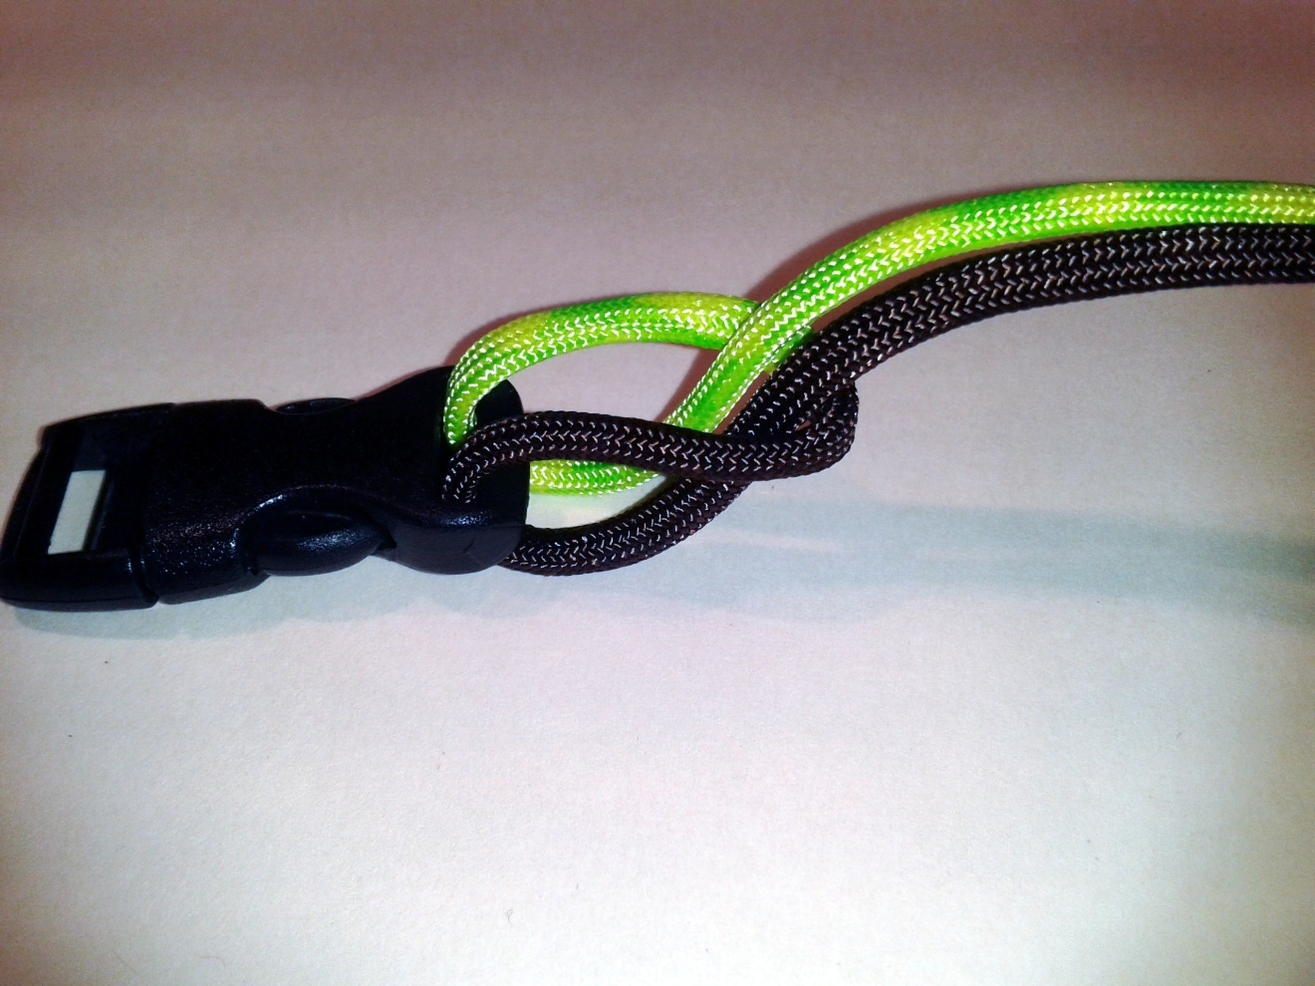
Step 3 : Pull tails through loop

Slide 5
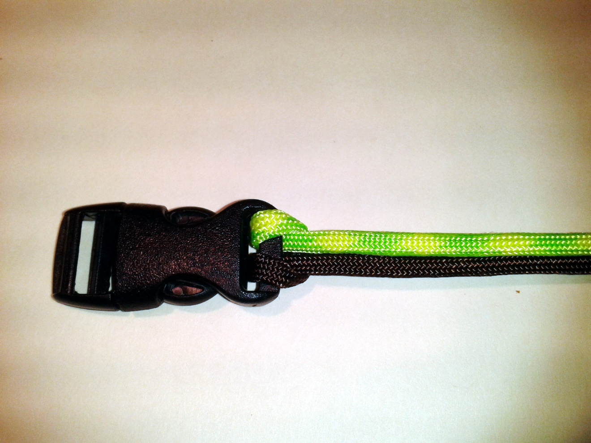
Step 4: Pull taught
Secures buckle to cord

Slide 6
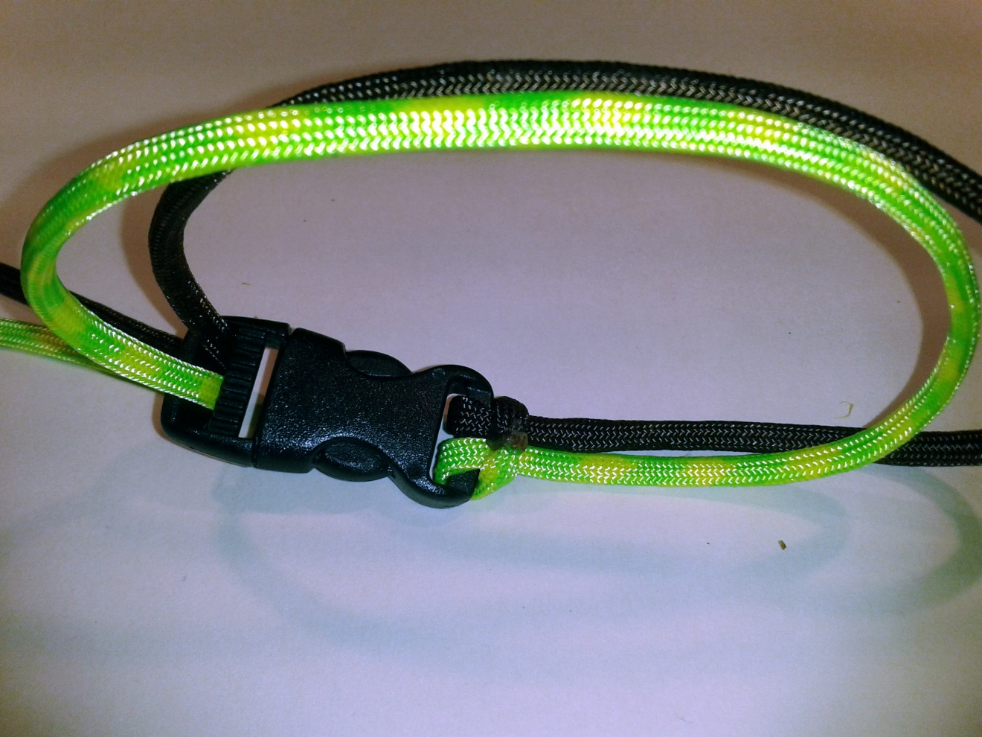
Step 5: Pull tails through 2nd buckle
Don’t pull taught – Once tails fed through 2nd buckle, unclasp.

Slide 7
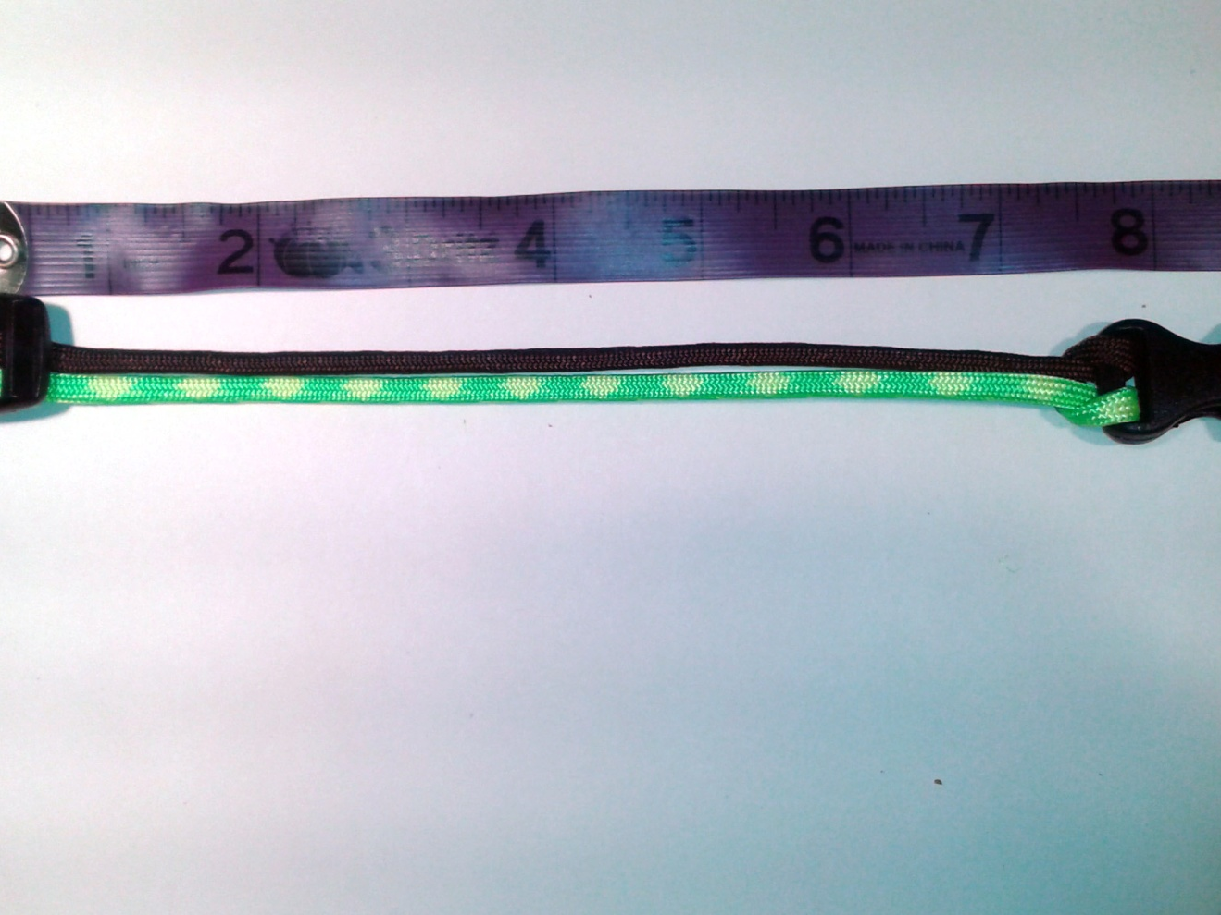
Step 6: Measure end to end
Lay out the unbuckled piece. Measure from flat end to flat end of buckle (do NOT measure prongs). Add 0.5” – 1.0” more than your wrist length.

Slide 8
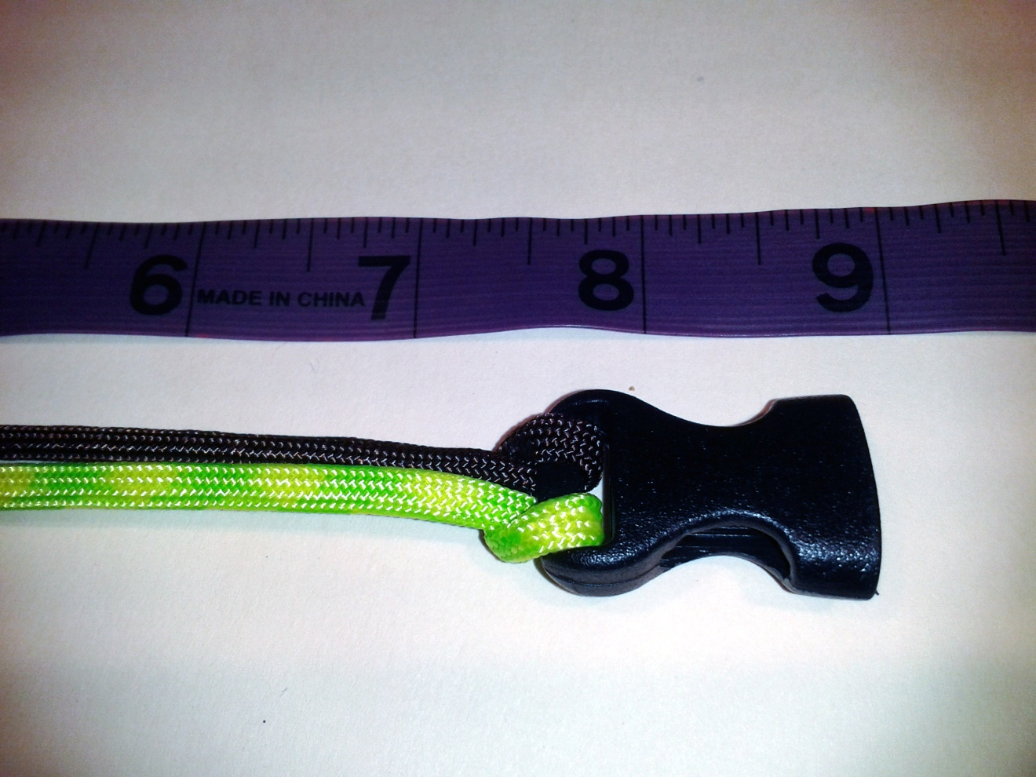
Step 6(a): Confirm measurement

Slide 9
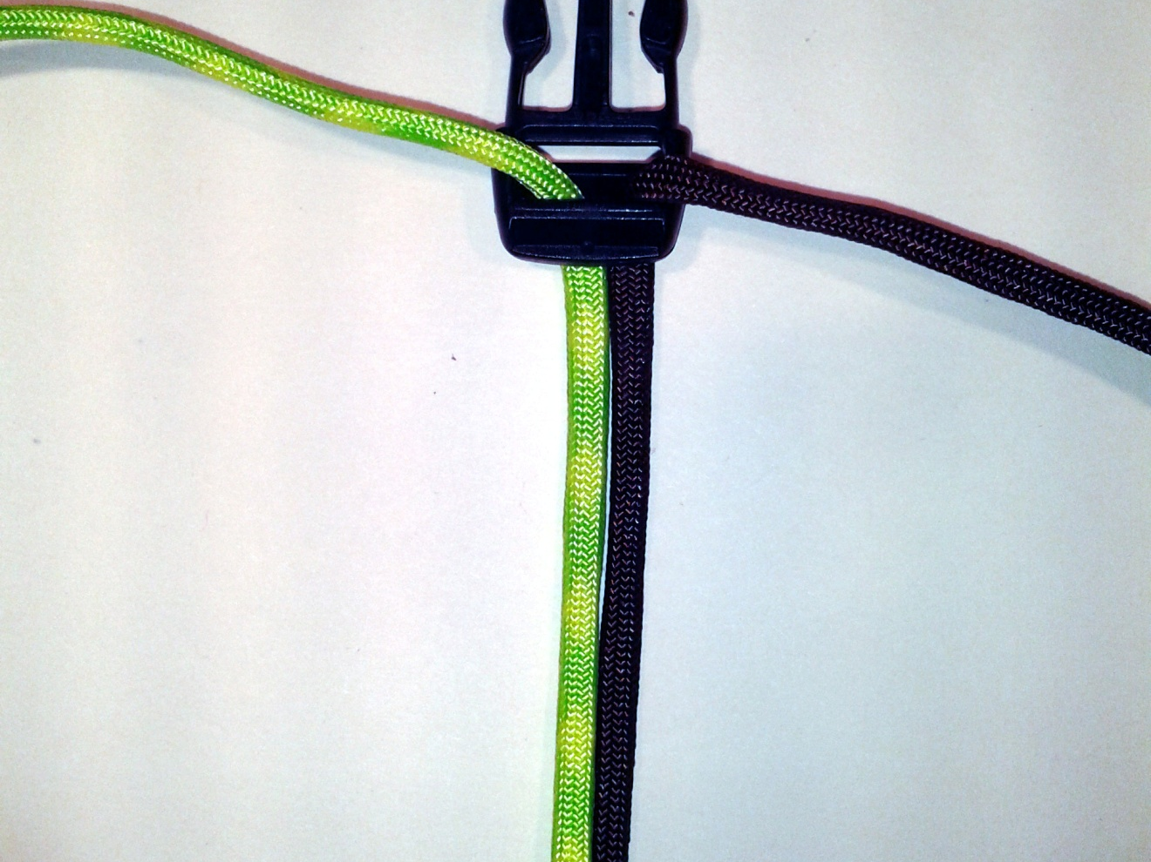
Step 7: Lay flat and begin
Make sure there are no twists along the cord.

Slide 10
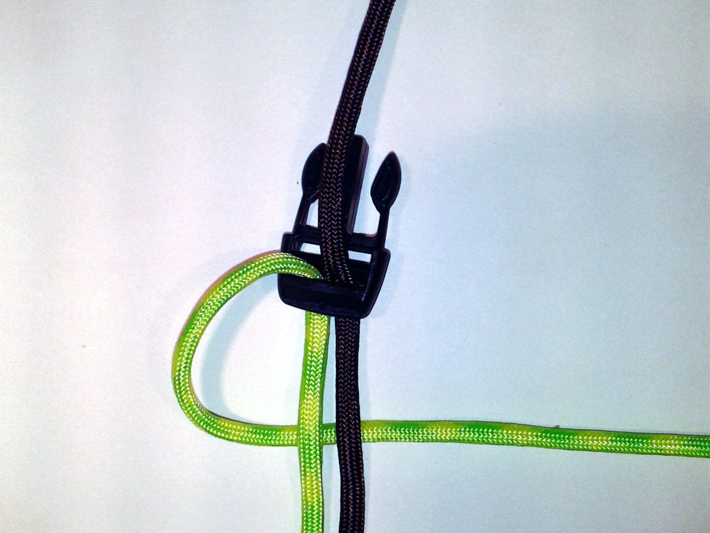
Step 8: Tie a simple knot
Pull one cord over the buckle edge and loop under both paracord strands

Slide 11
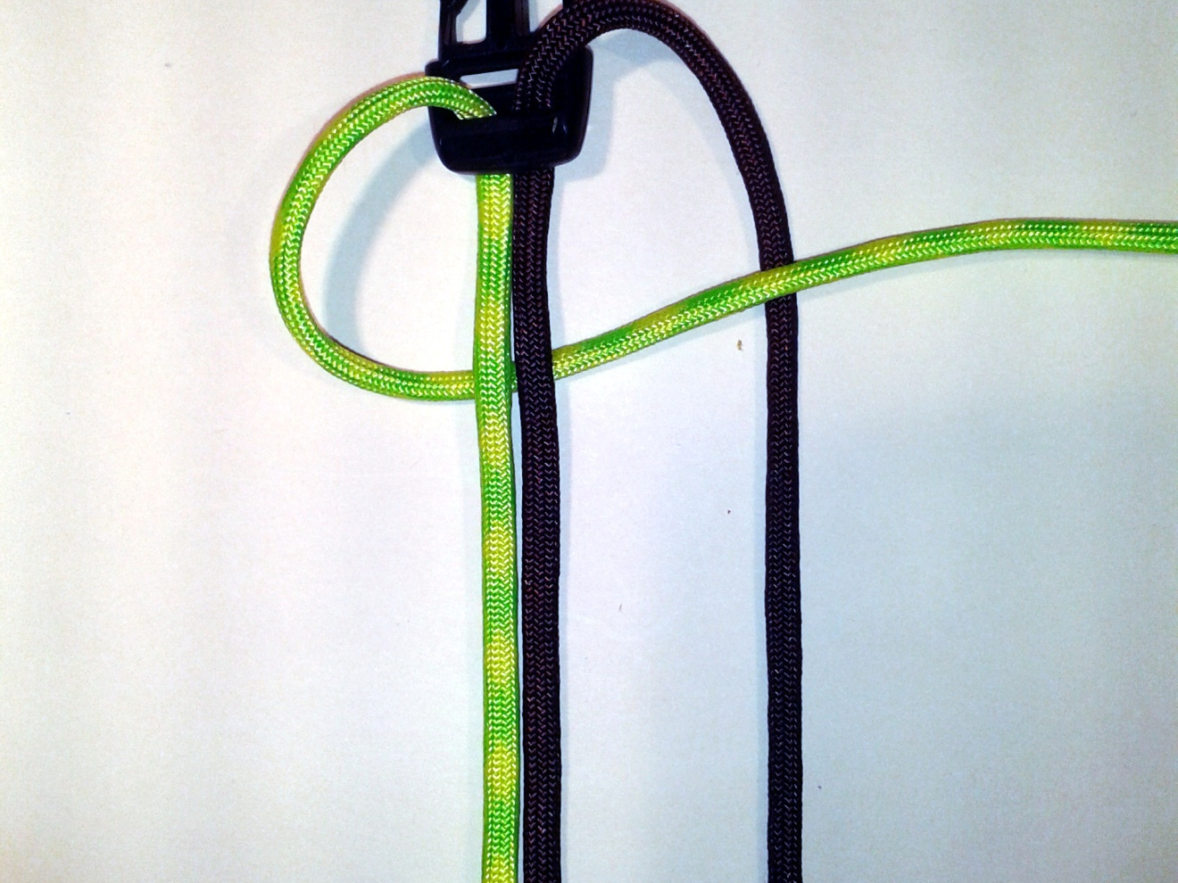
Step 8(a): Continue simple knot
Pull second strand over buckle edge and under first paracord strand

Slide 12
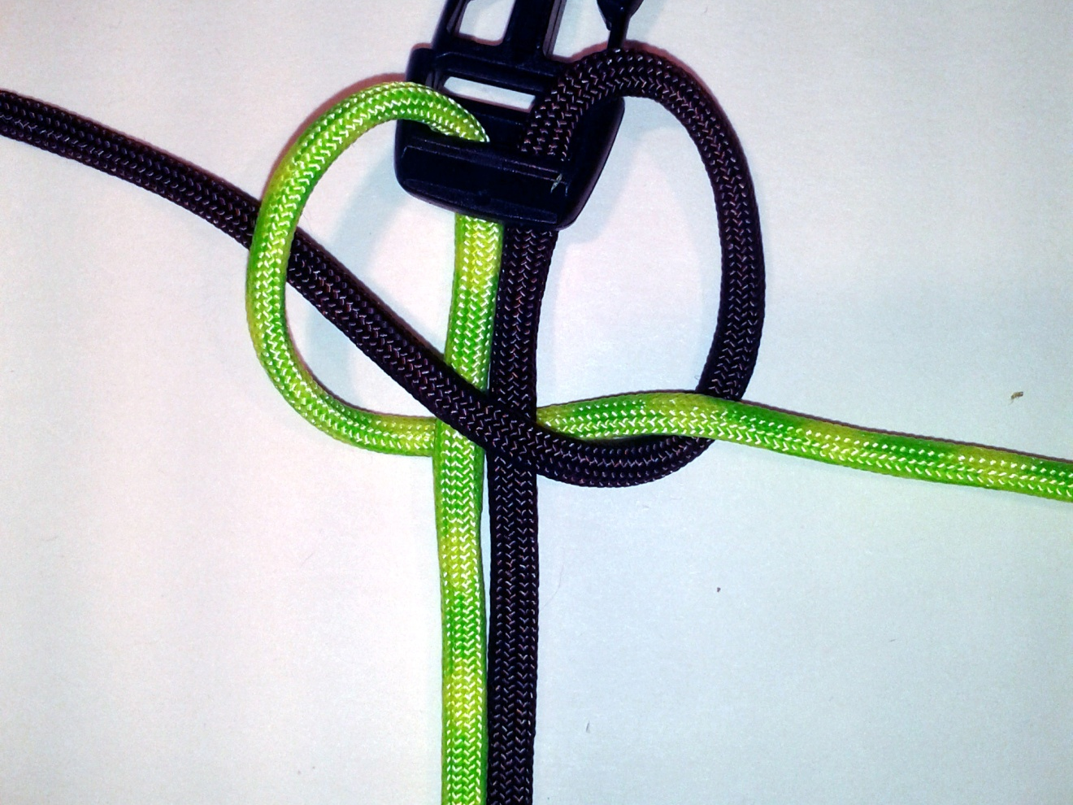
Step 8(b): Continue the knot
Feed second cord through over both cord strands and feed through loop created by first cord

Slide 13
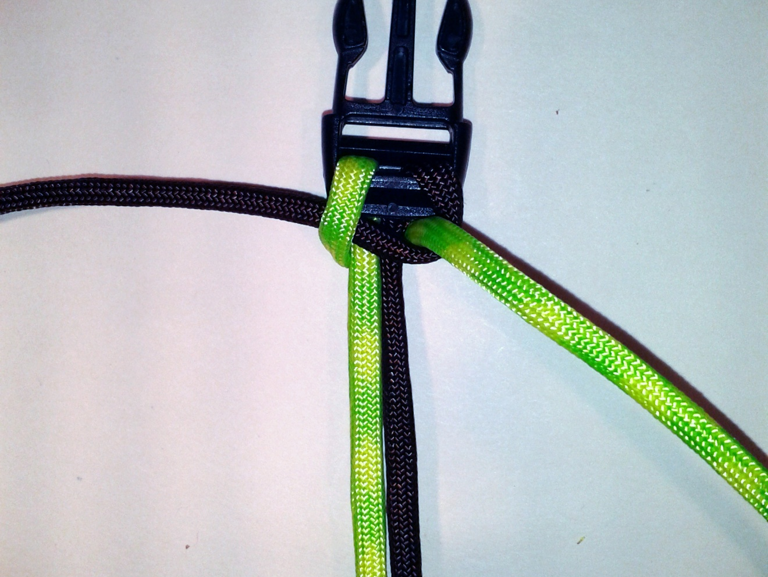
Step 8(c): Finish knot
Pull both cords taught

Slide 14
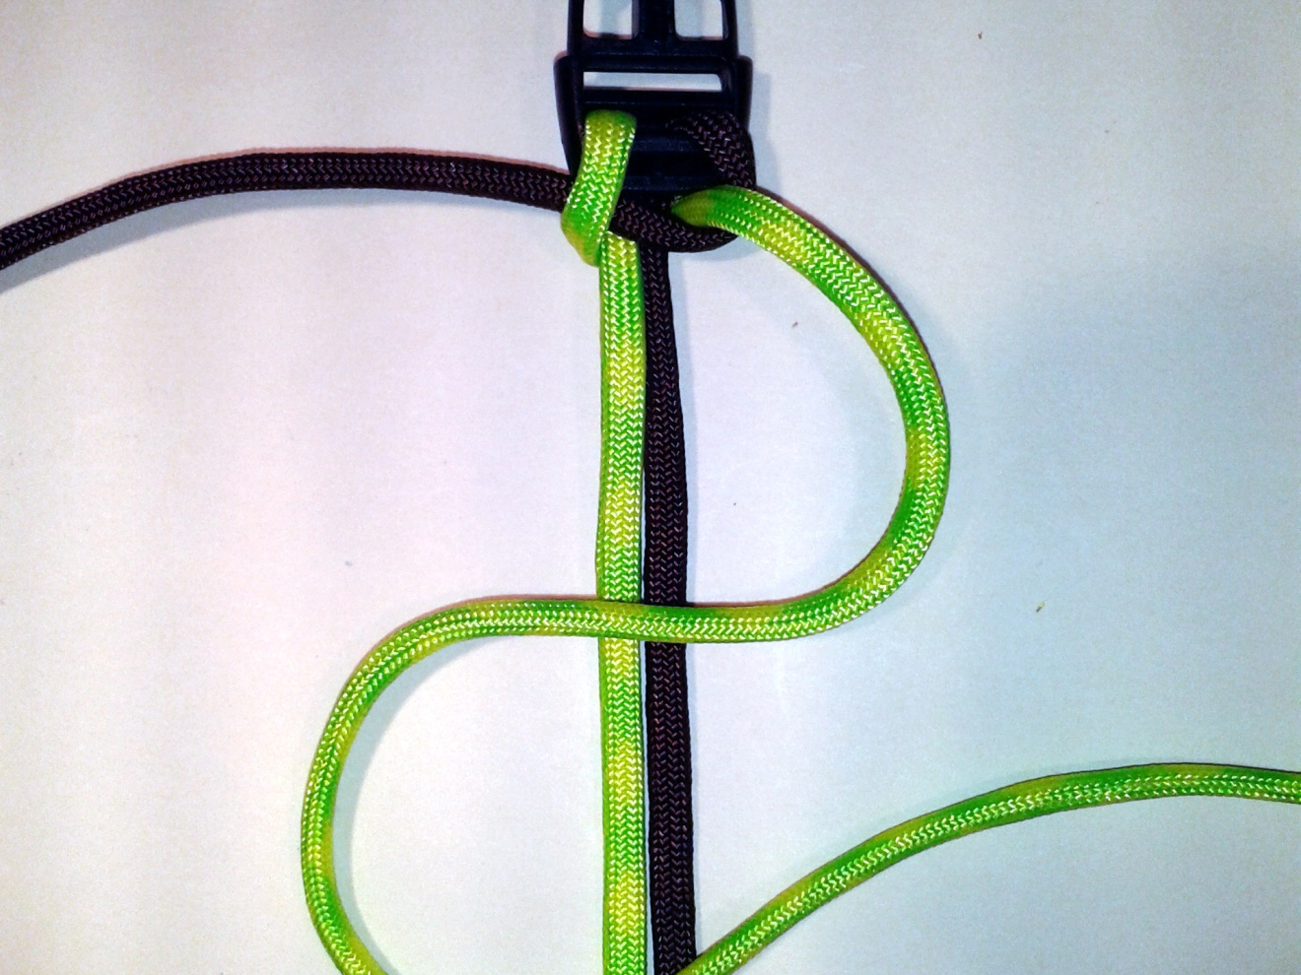
Step 9: Beginning cobra stitch (Right)
Take the right side cord and create a backwards “S” over both paracord strands

Slide 15
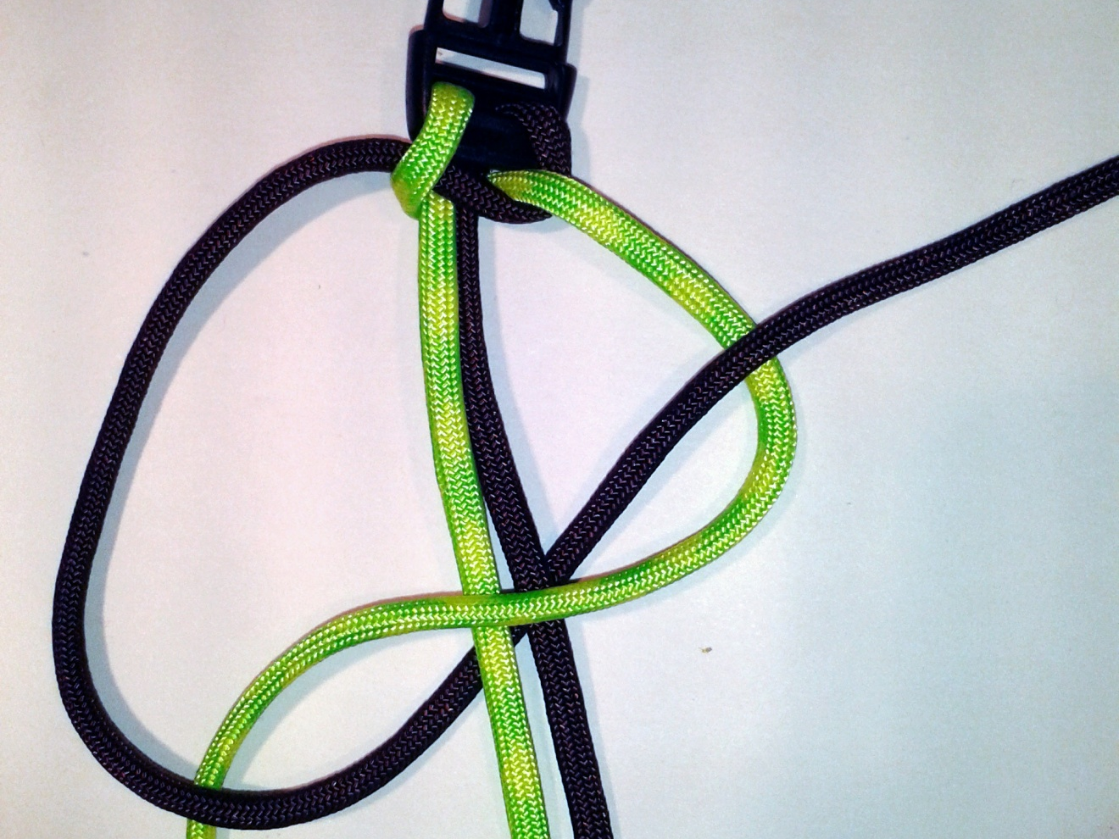
Step 9(a): Continuing first Cobra stitch
Pull the 2nd strand over and through the “lower S”, completely under both paracord strands, and through and over the “upper S”

Slide 16
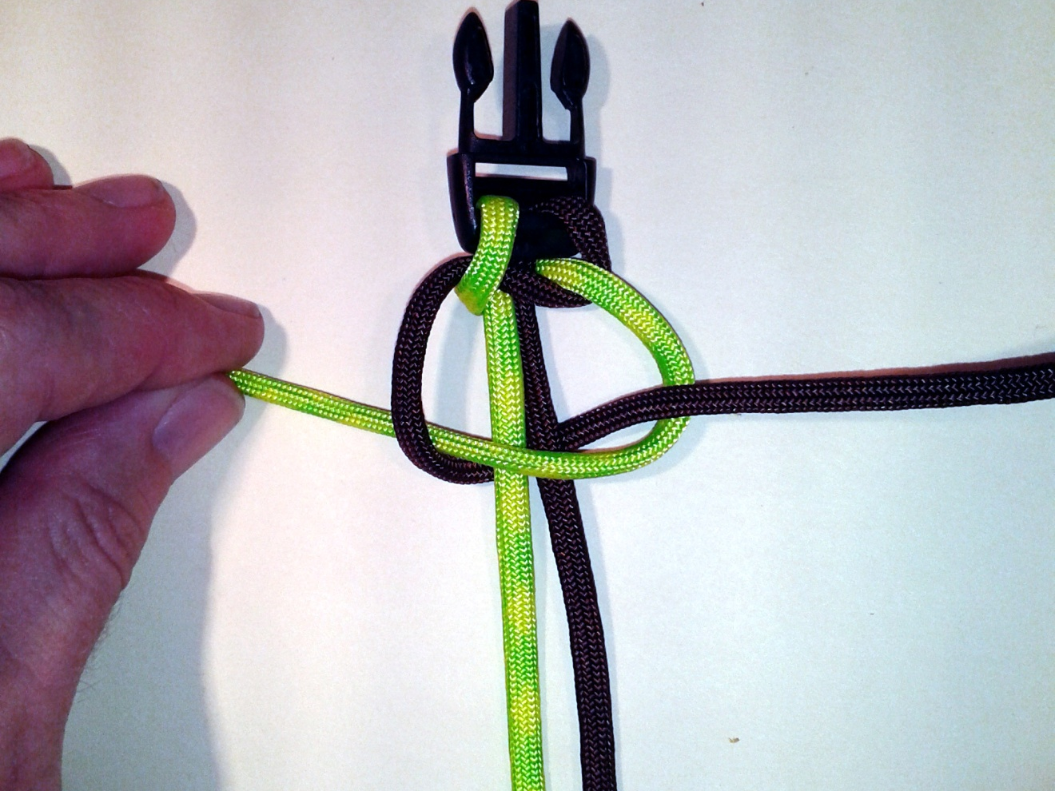
Step 9(b): Continuing first Cobra stitch
Pull each strand taught, together and equally

Slide 17
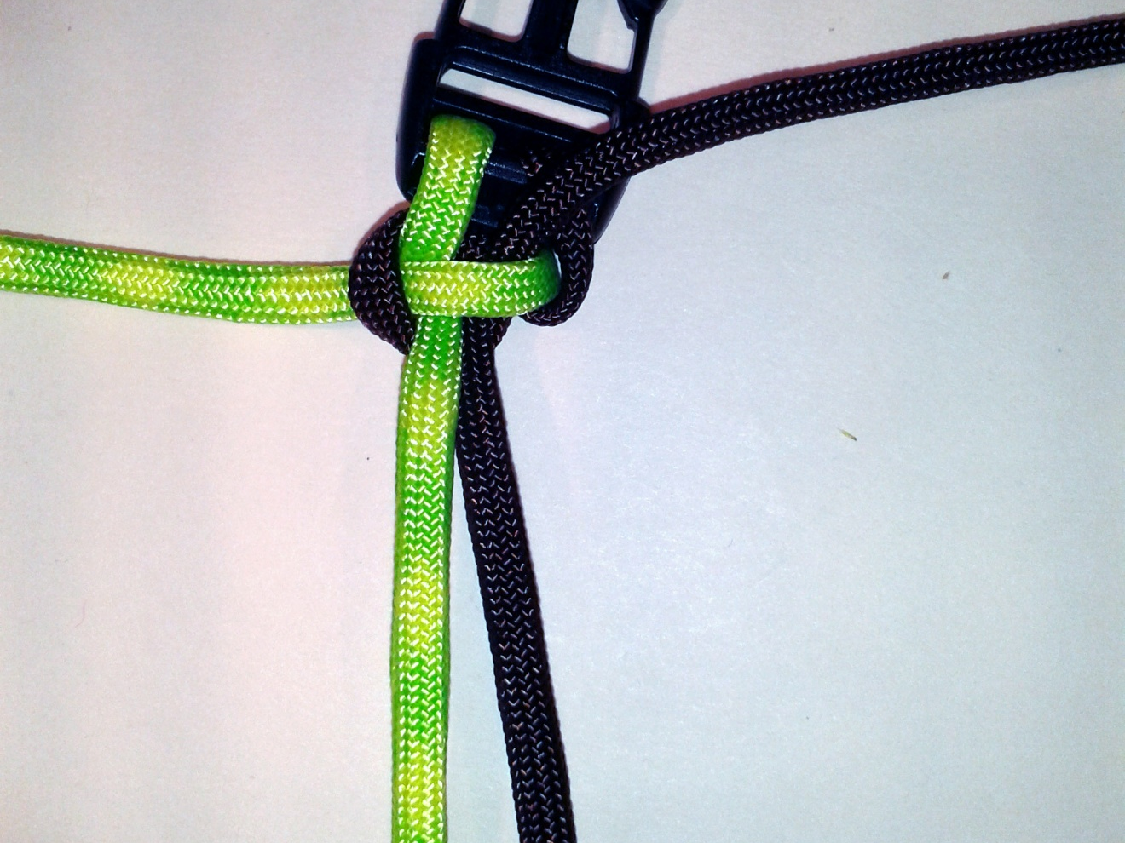
Step 9(c): Finished first Cobra stitch
Looks a little messy at first…

Slide 18
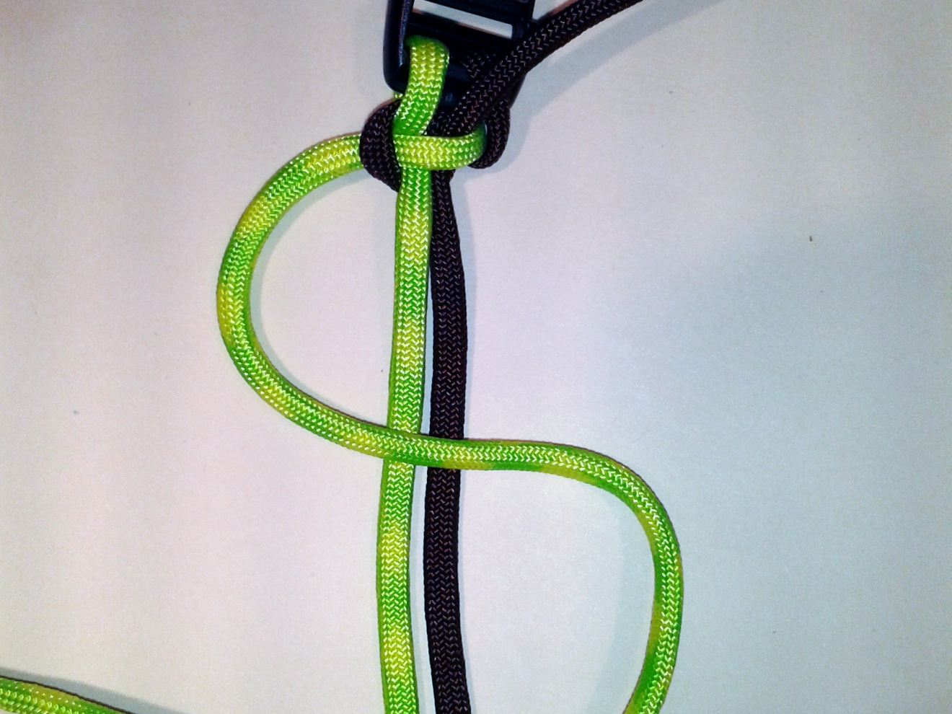
Step 10: Beginning second Cobra stitch (Left)
Repeat Step 9-9(c), but now going the other direction. Create an “S” using the same beginning strand. Notice the “bump” on the left? You’ll always lead with the strand coming out from that bump…

Slide 19
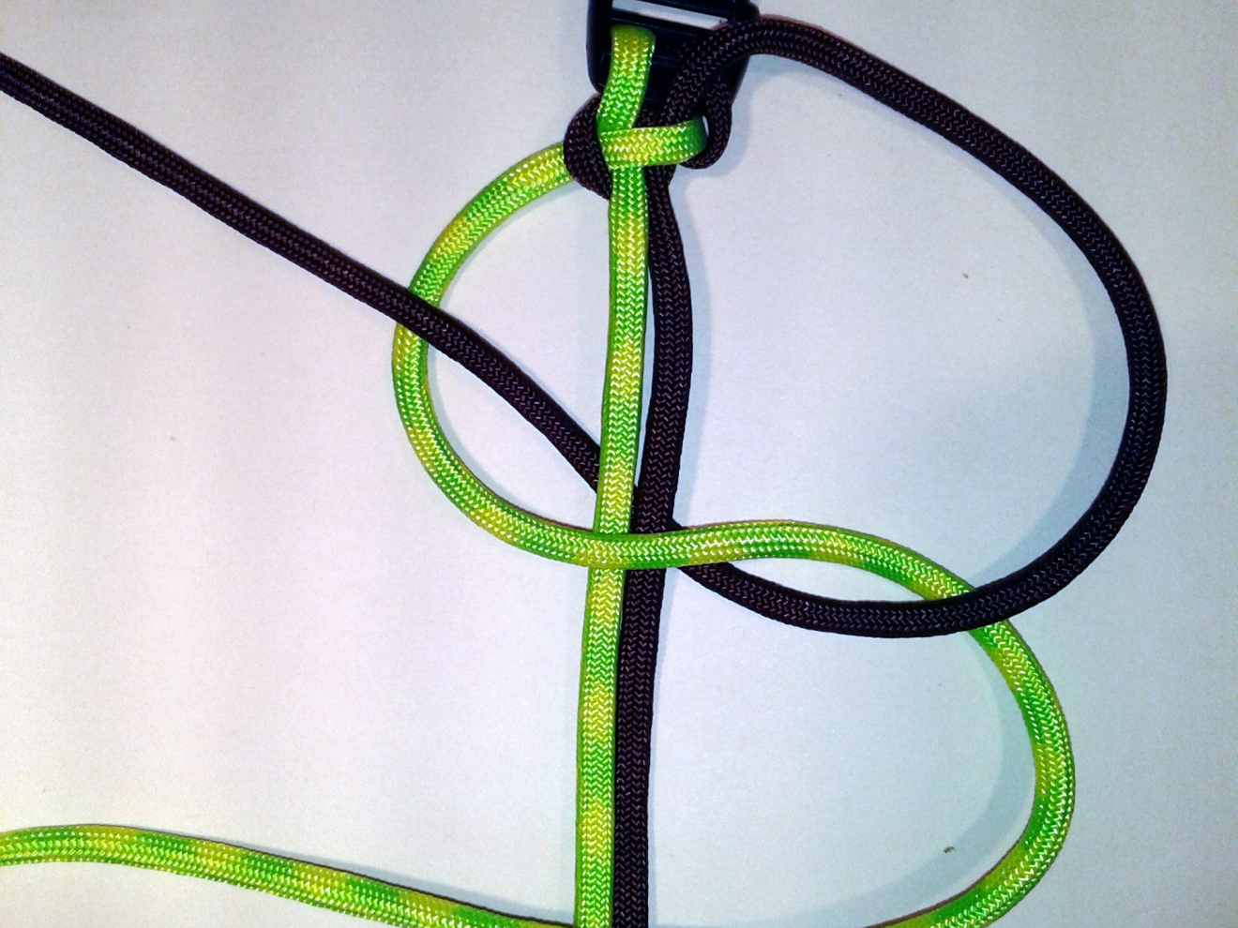
Step 10(a): Continuing second Cobra stitch
Pull the 2nd strand over and through the “lower S”, completely under both paracord strands, and through and over the “upper S”

Slide 20
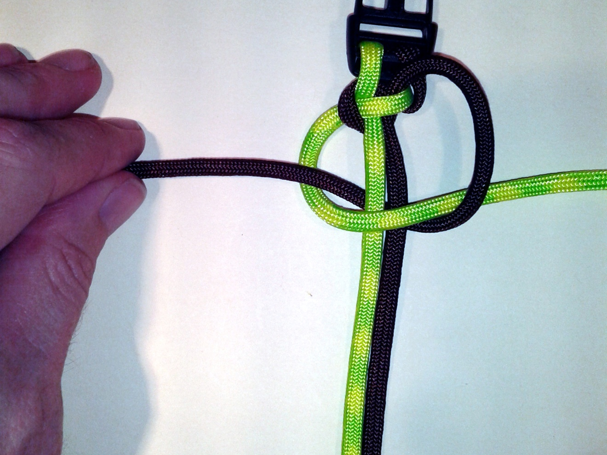
Step 10(b): Continuing second Cobra stitch
Pull each strand taught, together and equally

Slide 21
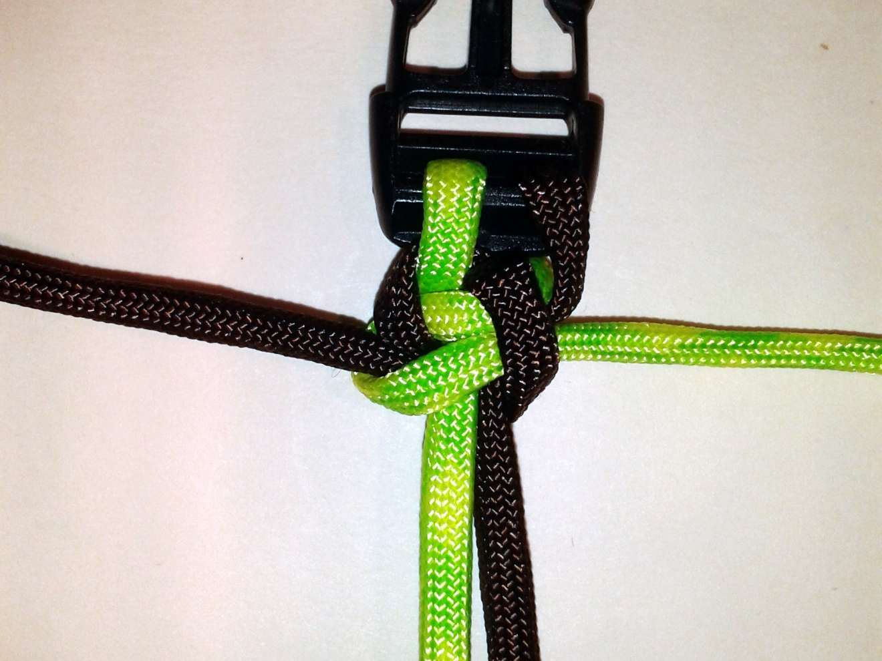
Step 10(c): Finished second Cobra stitch
Still lookin’ a bit messy…

Slide 22
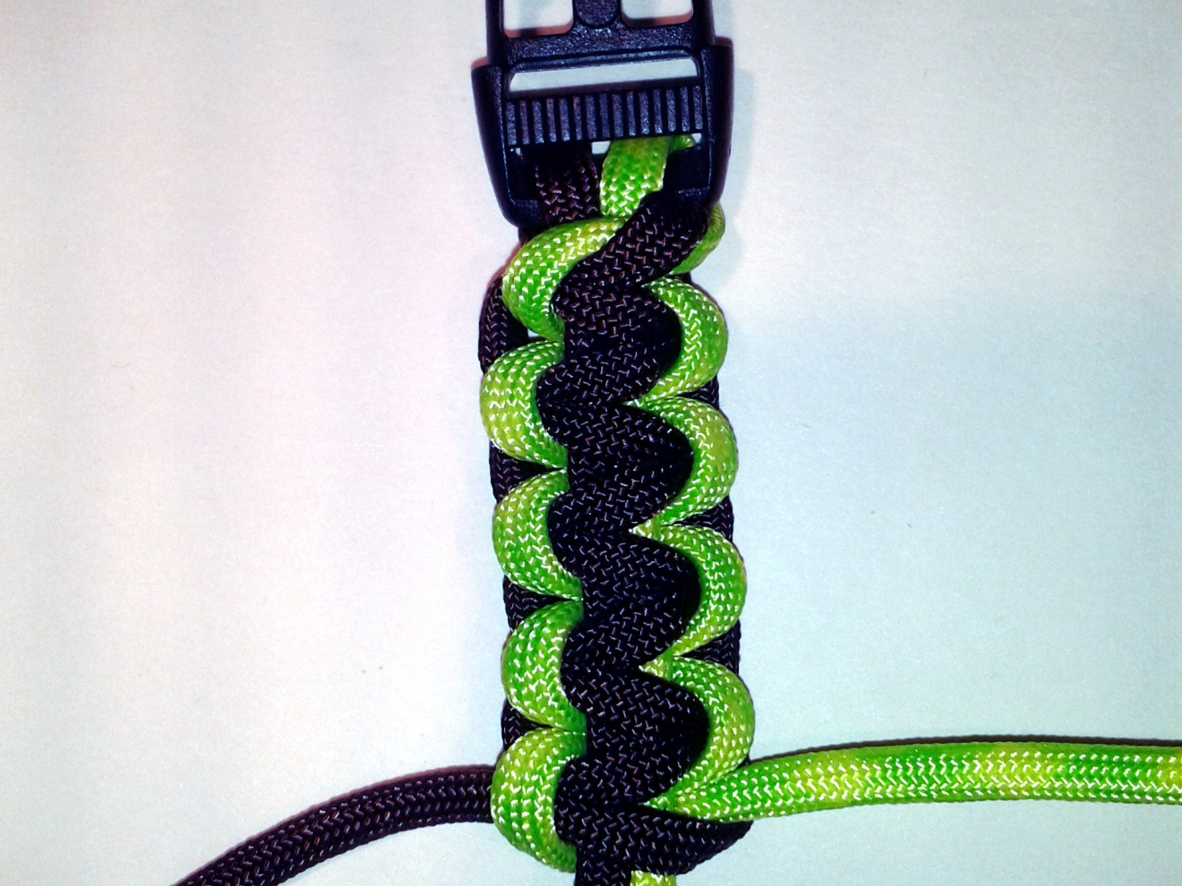
Step 11: Repeat steps 9-10(c)
Pull each weave tight, pay attention to your pattern, look for any mistakes…

Slide 23
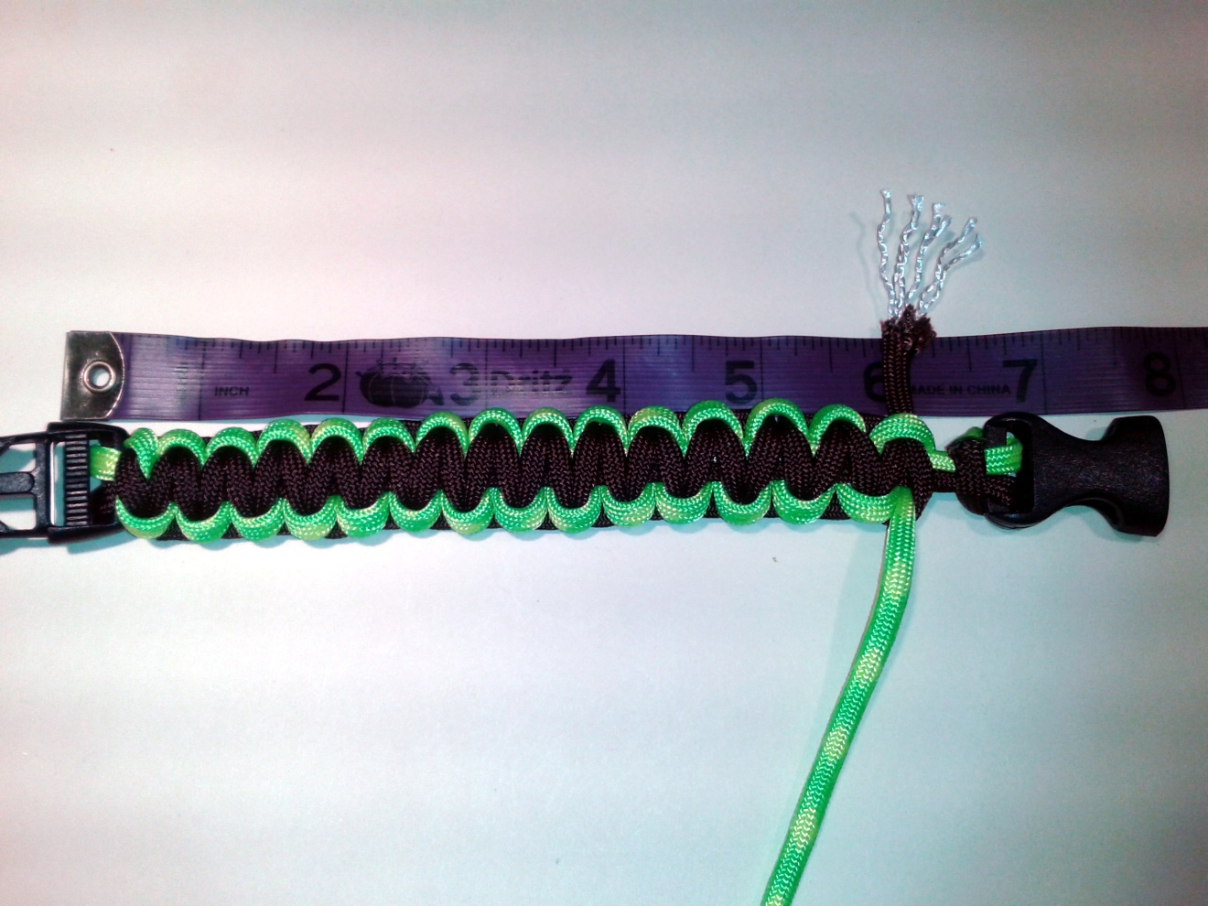
Step 12: End of the line
I’ve run out of cord…Measure the bracelet again – you may even want to try it on. If it doesn’t fit correctly, unweave the bracelet, adjust the distance of the strands, and weave again. Practice makes perfect…do NOT progress to Step 13 until you’ve got a comfortable fit.

Slide 24
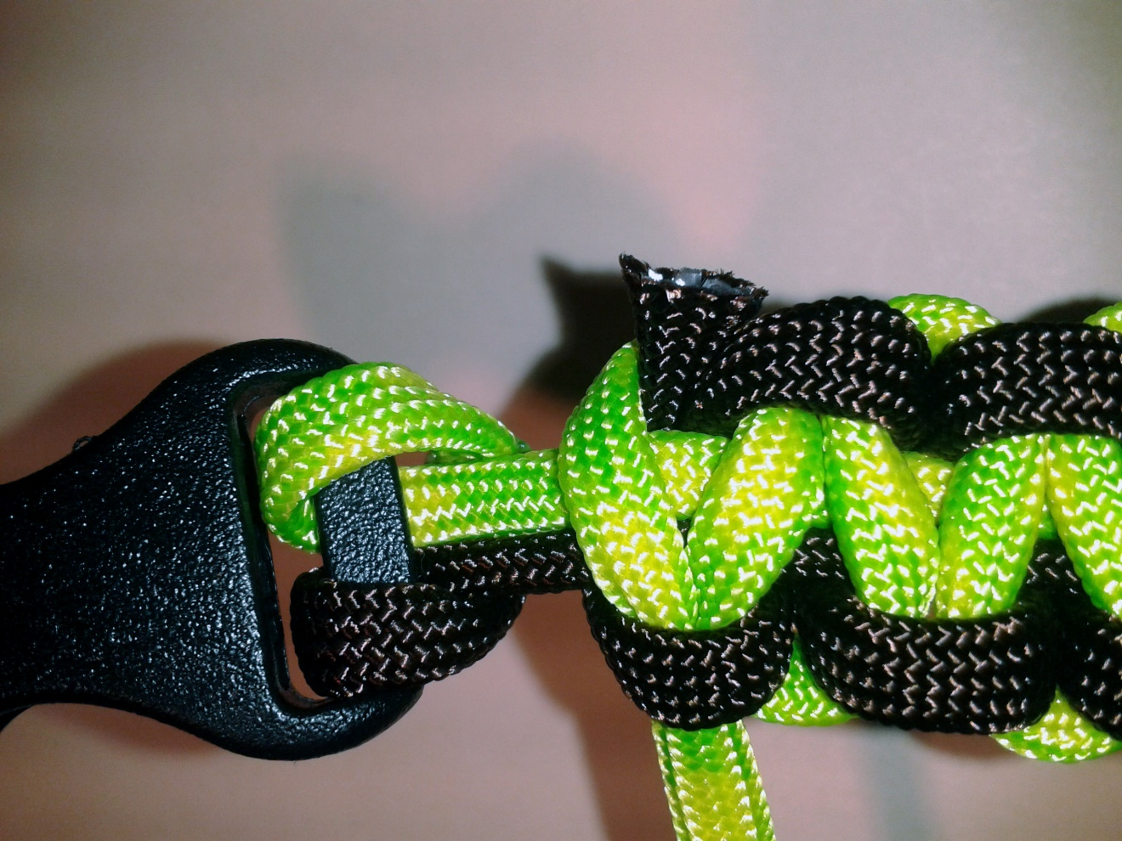
Step 13: Cut one cord at a time
Cut one strand close to the body of the bracelet. Grab a lighter & scissors. Burn the tip of the exposed cord until it bubbles a bit…then push the scissors flat against the melting cord; remove scissors…

Slide 25
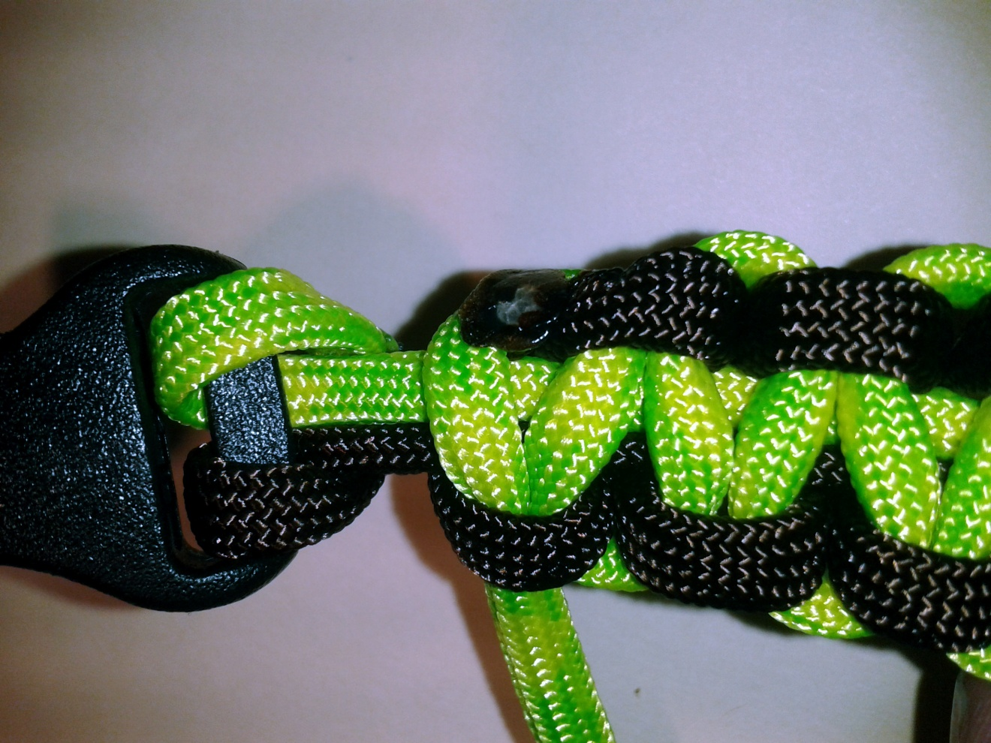
Step 13(a): Sealed cord
If done correctly, your newly melted & flattened cord end should look similar.

Slide 26
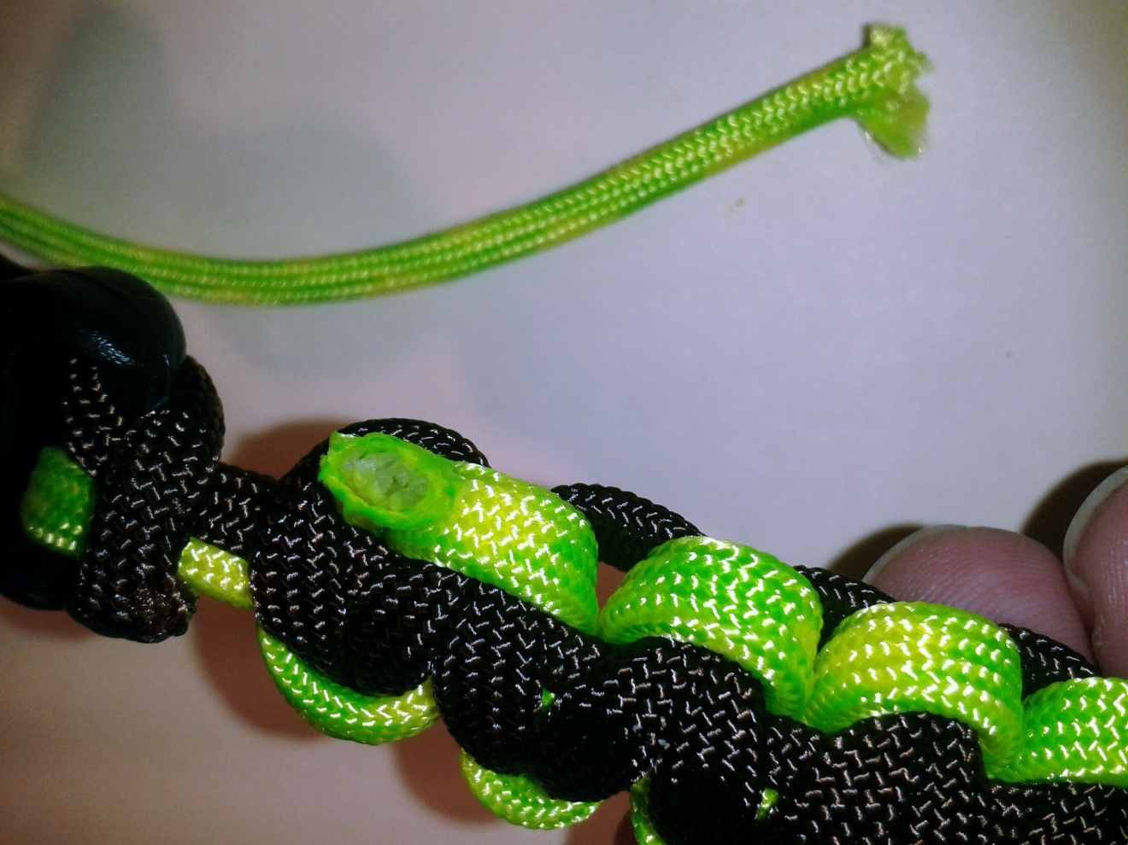
Step 13(b): Cut 2nd cord
Repeat Step 13 for 2nd strand of paracord. Cut it close to the body of the bracelet, burn it until it melts, press firmly flat with edge of scissors

Slide 27
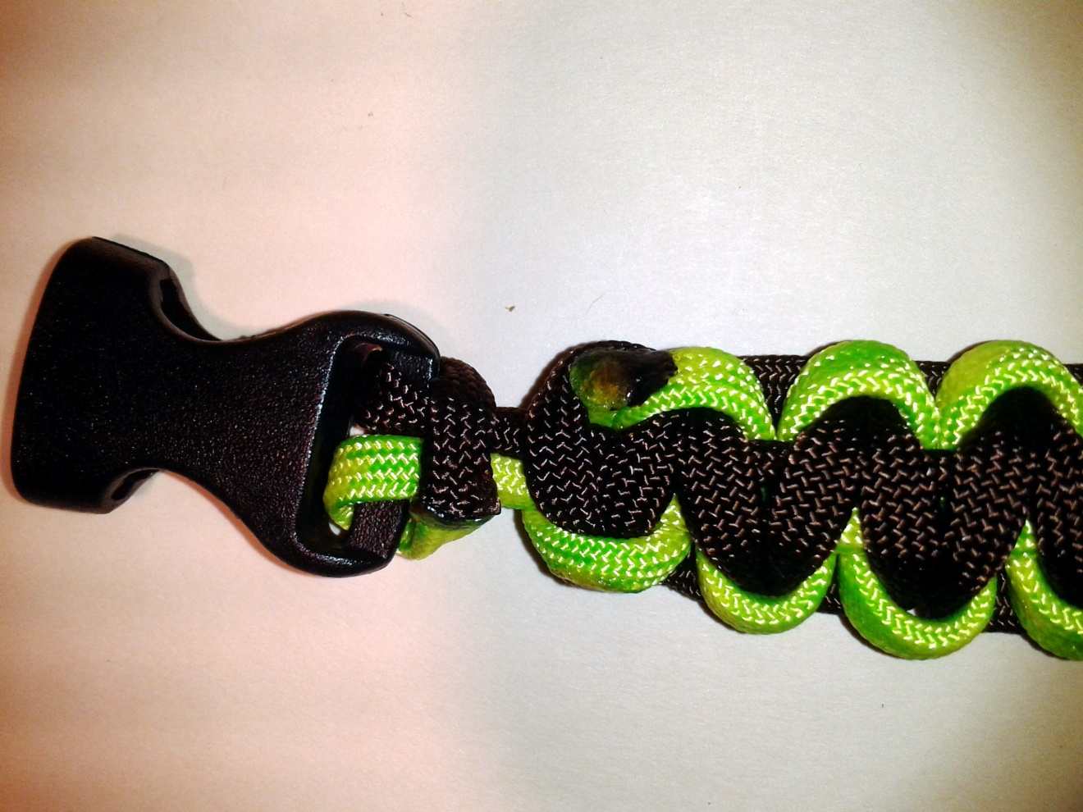
Step 13(c): Sealed 2nd cord
If done correctly, your cord should look similar

Slide 28

Other uses of Paracord
Other weaves/projects
Snares
Rifle slings
Emergency rescue rope
Tent and/or hammock tie lines
Dental floss
Bridle
Water bottle holsters
Leashes and belts
Guide lines
Sealant
Cobra stitch
King Cobra stitch
Crown Sinnet stitch
Caterpillar Sinnet stitch
Wide Solomon Bar stitch
Saw Tooth stitch
Snake Knott stitch
Fishtail stitch
Gear wraps
Monkey fists

